Slide 1

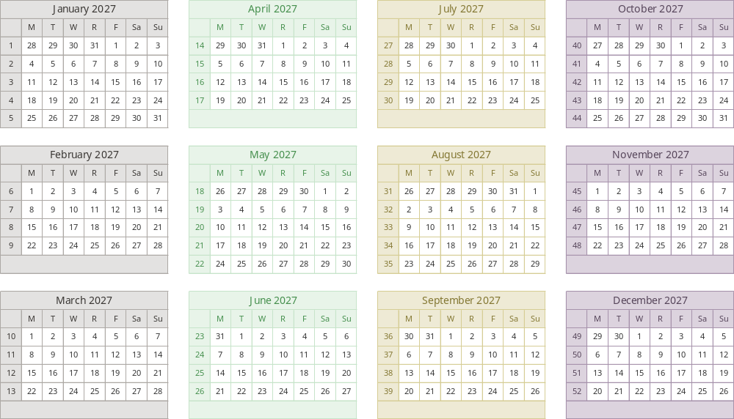
2027 Broadcast Calendar
Courtesy of Bionic Advertising Systems
Media Planning and Media Buying Software
www.Bionic-Ads.com

Slide 2
2027 Broadcast Calendar
Courtesy of Bionic Advertising Systems
Media Planning and Media Buying Software
www.Bionic-Ads.com

